Slide 1
Evidence-based Treatments Targeting Aging
ETTA Biotechnology

Slide 2
ETTA Makes the Most Powerful Aging Interventions
ETTA
1 year
40+ people dosed
90%+ efficacy in tests and case studies
ETTA Biotechnology
Kyle Brewer - ETTA Biotechnology

Slide 3
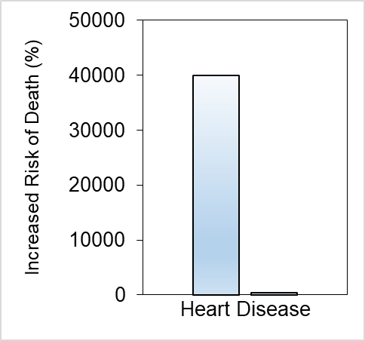

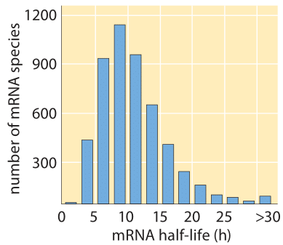
100×
Larger effect size over traditional approaches by targeting aging.
200+ Cell Types
Nanoparticle Platform
Developing the ability to target all cells, not just a few.
1 Day to
10 Year
Gene Therapy Platform
The versatility of mRNA
without the transience.
Aging
High
Cholesterol
ETTA Biotechnology

Slide 4
Founder: Kyle Brewer
Designed and developed >100 preclinical mRNA and DNA therapies.
Second scientist at Rejuvenation Technologies, a Stanford mRNA startup.
Postdoc at Stanford in the Wyss-Coray lab (young blood factors for brain rejuvenation).
2 patents filed for ETTA Biotechnology (oral and topical fisetin nanoparticles).
ETTA Biotechnology

Slide 5
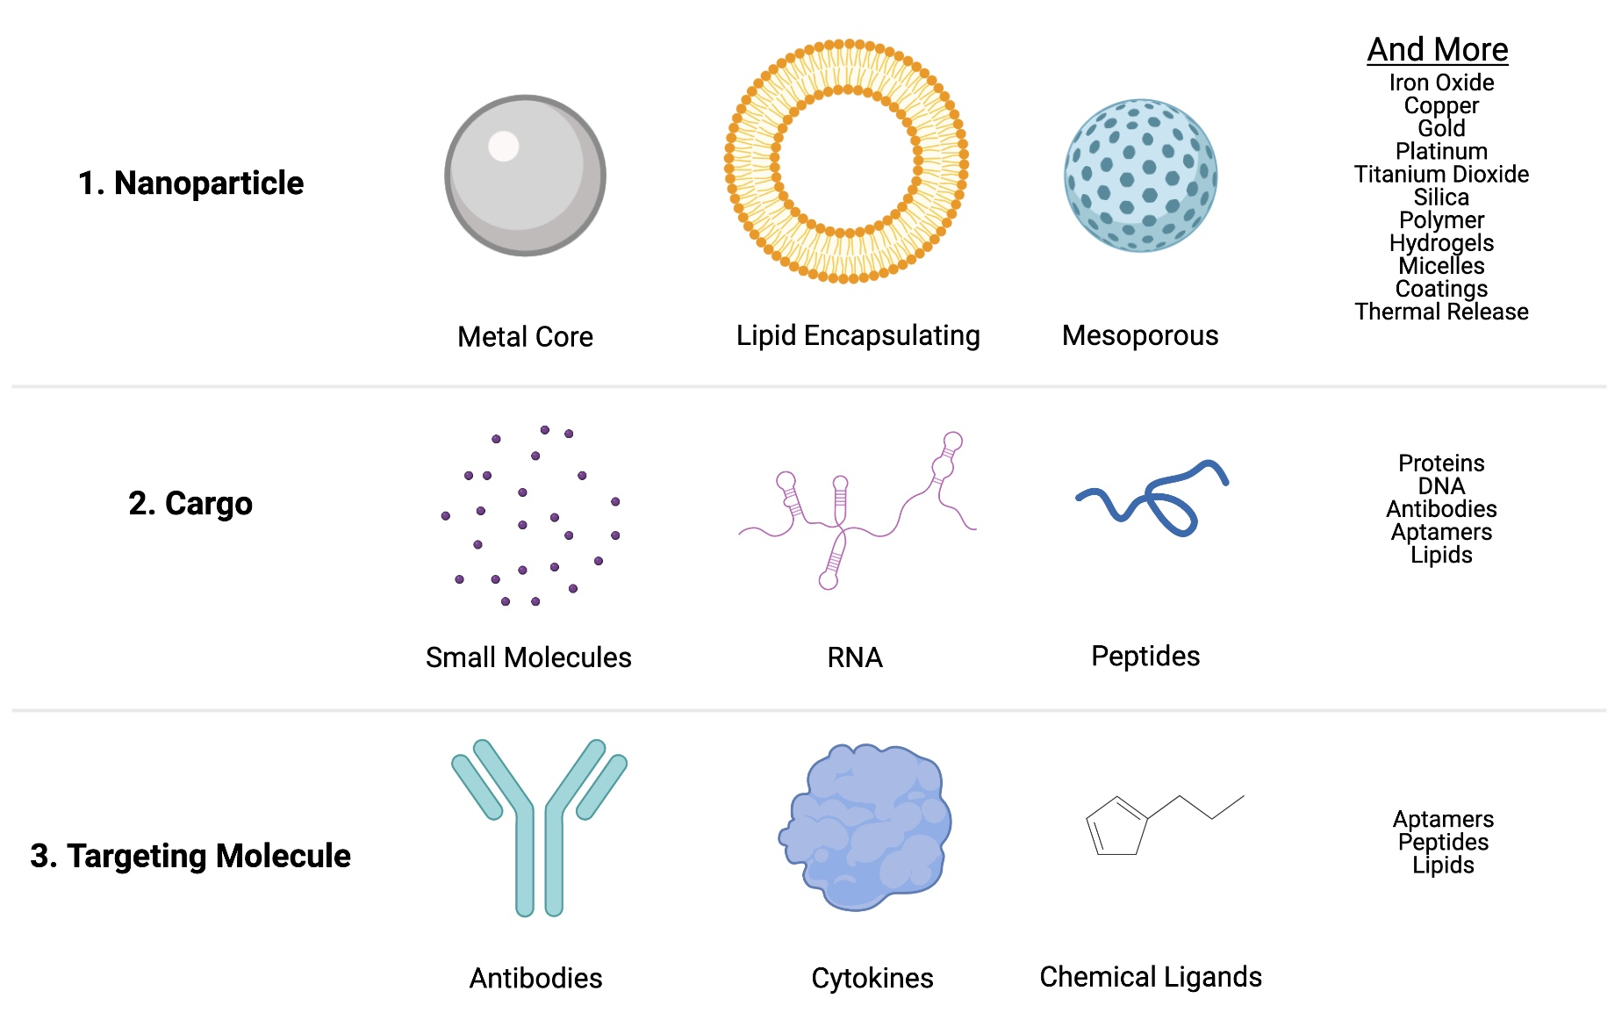
ETTA's Nanoparticle Platform
ETTA Biotechnology

Slide 6
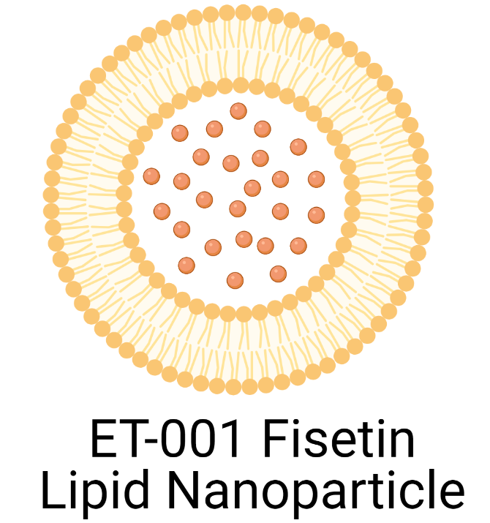
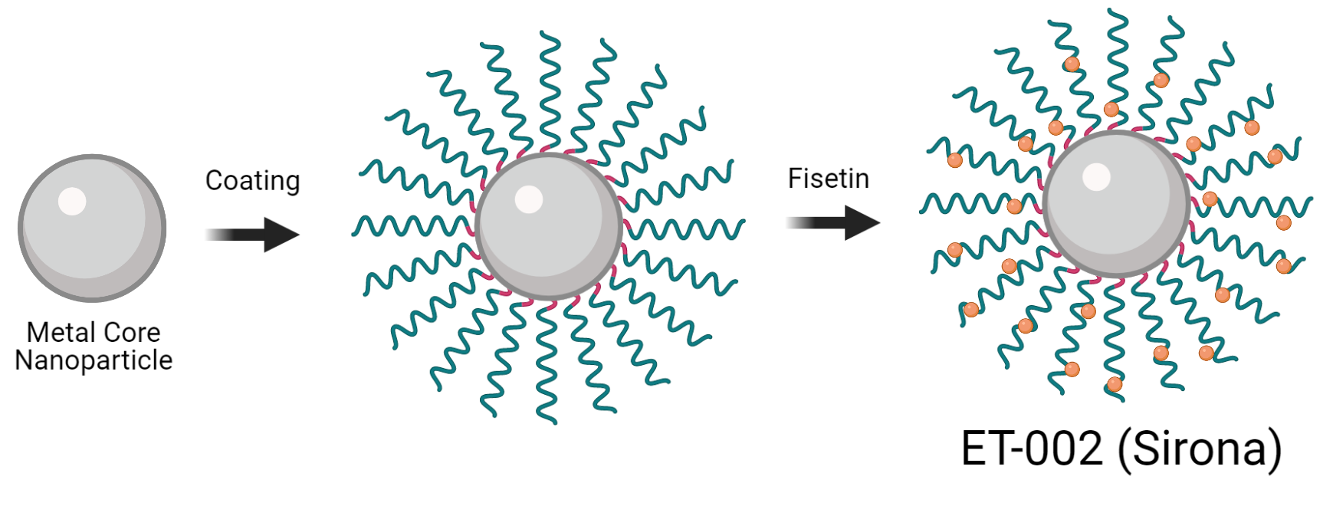

Our Nanoparticles
Oral Fisetin Nanoparticle
Topical Fisetin Nanoparticle
ET-001
IP Filed
ET-002
IP Filed
Gene X Nanoparticle
mRNA Reprogramming Nanoparticle
ET-003
Designed
ET-004
Planned
ETTA Biotechnology

Slide 7
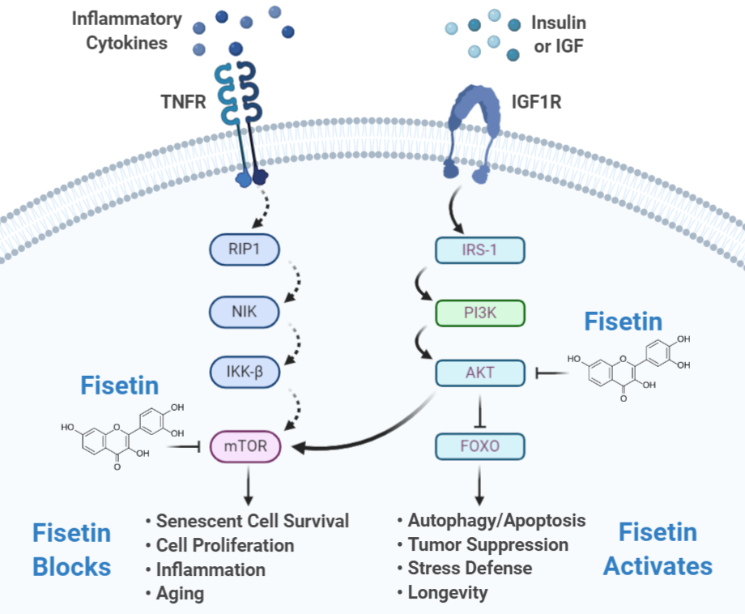
Fisetin as a Therapeutic for Aging
1. Insulin Signaling Inhibition
2. mTOR (Rapamycin target) Inhibition
3. Senescent Cell Removal
ETTA Biotechnology
Kyle Brewer - ETTA Biotechnology
Matthew J Yousefzadeh et al, 2018 EBioMedicine
Vaqar Mustafa Adhami et al, 2012 Biochem Pharmacol

Slide 8
Emerging Evidence for Benefits of Fisetin In:
Crohn's Disease and Colitis, Poor Digestion
Psoriasis, Dermatitis, Scarring
Alzheimer's, Parkinson's, Huntington's, Multiple Sclerosis, Dementia, Neurodegeneration, Poor Sleep, Headaches
Heart Disease, Atherosclerosis, Stroke, Hypertension, Heart Failure, Cardiomyopathy, Vascular Disease, Calcification
Chronic Obstructive Pulmonary Disease (COPD), Pulmonary Fibrosis, Tobacco/Vaping (Smokers Lung)
Fatty Liver Disease, Liver Cirrhosis, Kidney Disease, Renal Failure
Cancer (Colon, Lung, Brain, Skin, Gastric, Kidney, Liver, Pancreas, Lymphoma, Melanoma)
Osteoporosis. Osteoarthritis, Sarcopenia, Frailty
Progeria, Cockayne Syndrome, Werner Syndrome
Macular Degeneration, Cataracts, Glaucoma
Organ Transplantation Failure
Prostate Hypertrophy
Diabetes, Obesity
Hay Fever, Asthma
Inflammation, Lupus
COVID-19, Influenza, Infections, Wound Healing
Lifespan, Healthspan, Fertility
ETTA Biotechnology
Harish C. Pal et al., 2016 Adv Exp Med Biol
Muhammad Imran et al., 2020 Food Sci Nutr

Slide 9
ET-001: Our Proprietary Oral Fisetin Nanoparticles for Aging
3 People Dosed During Preliminary Safety Study:
No Negative Side Effects Observed or Reported at Highest Dose
Unexpected Early Results:
1. Improved Digestion
2. Chronic Joint Pain Permanently Relieved
3. Blood Sugar Level Lowered to Normal Level (7.3 mmol/L to 5.1 mmol/L)
4. Slight Weight Loss (0-2 kg - All Normal Weight Volunteers)
5. Brain Clarity
6. Faster Wound Healing (2x faster)
7. Reduced Headaches
8. Improved Sleep Quality
IP Filed
ETTA Biotechnology

Slide 10
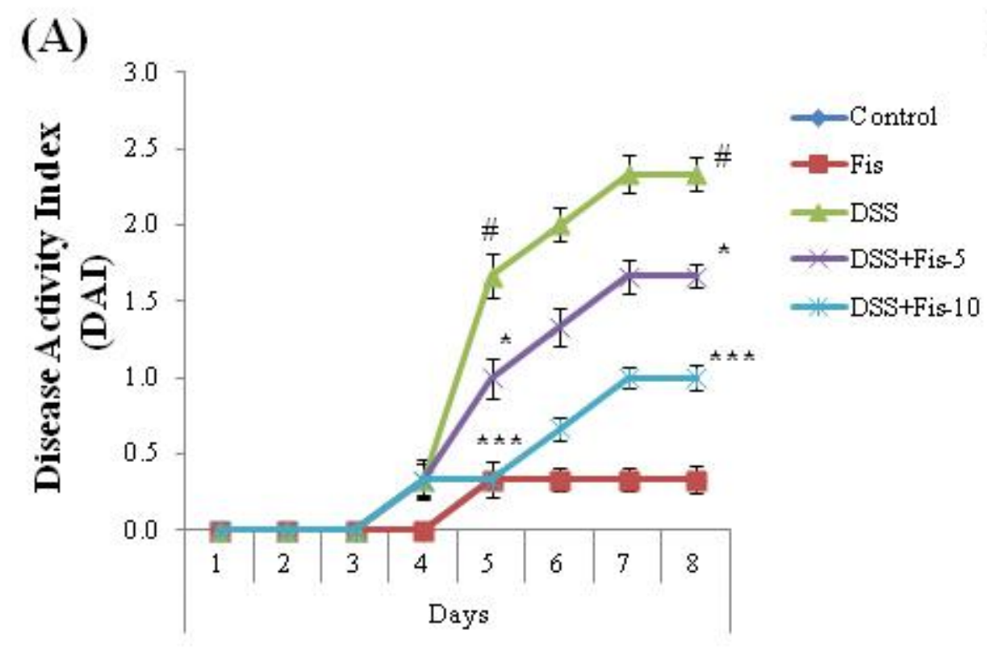
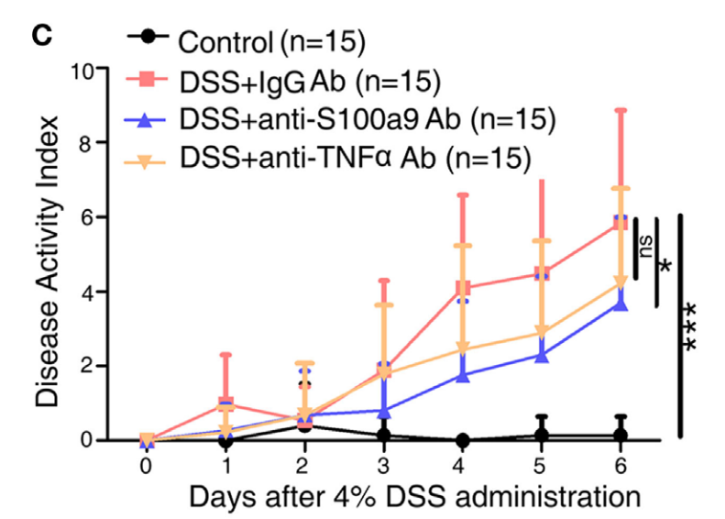
Fisetin: Inflammatory Bowel Disease (IBD) as Initial Indication
IBD - $20 Billion per Year Market
1,600,000 Million Patients in the US
Disease Index After Fisetin
Disease Index After Standard of Care Treatment
(anti-TNFα - Humira)
ETTA Biotechnology
Bidya Dhar Sahu et al., 2015 J Nutr Biochem
Xuemei Zhang et al., 2017 Front Immunol

Slide 11
Market Estimate for ET-001
Cost of production
$5 per dose (60 doses taken per year)
US, Europe, and China
1.25 billion people x $12000 profit per year = $15 trillion profit per year
Market Capitalization
$300 Trillion
Note: Humira costs $84,000 per year
ETTA Biotechnology

Slide 12
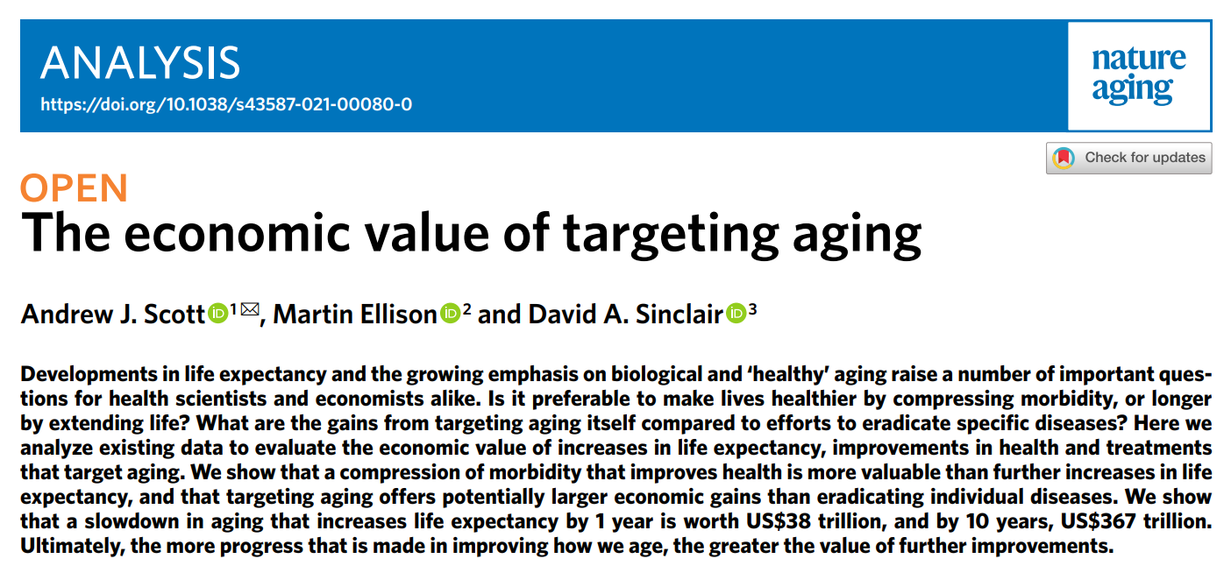

Economists: Increasing Life Expectancy Is Worth $367 Trillion
2019
ETTA Biotechnology

Slide 13
ET-002 (Sirona): Our Proprietary Topical Skin Nanoparticles
IP Filed
ETTA Biotechnology

Slide 14
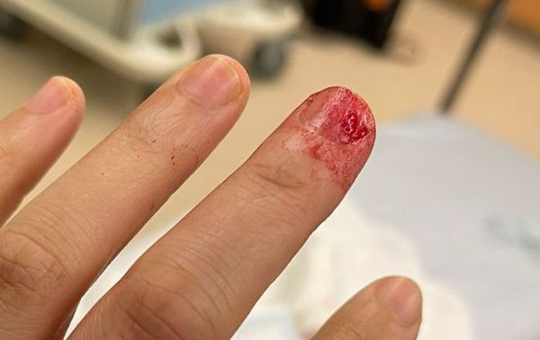
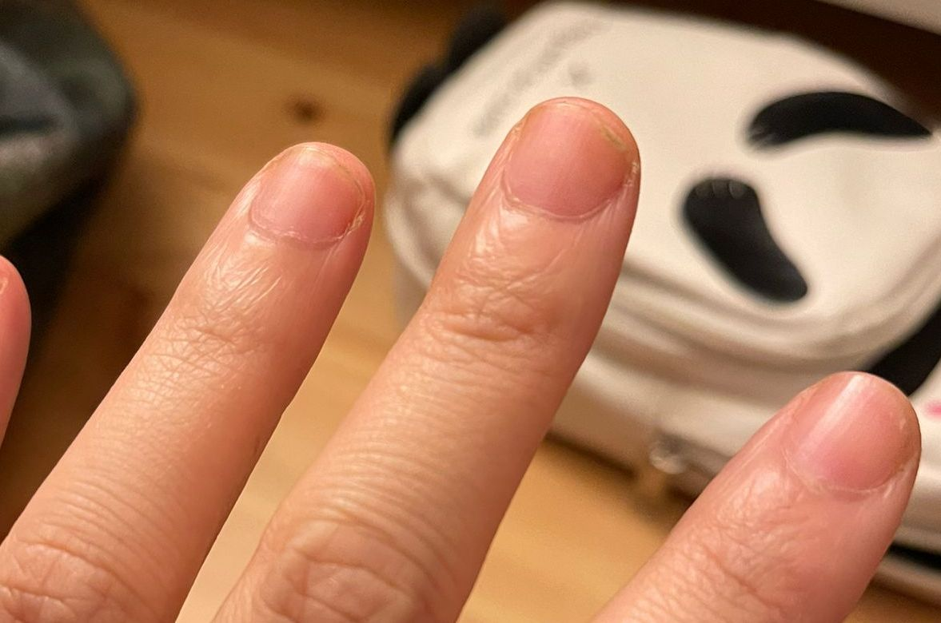
Case Study of Scar Prevention Using ET-002
Day 0 Day 60
Patient presented with fingernail and chunk of flesh missing.
Attending physician noted injury would definitely leave a scar.
ETTA Biotechnology

Slide 15
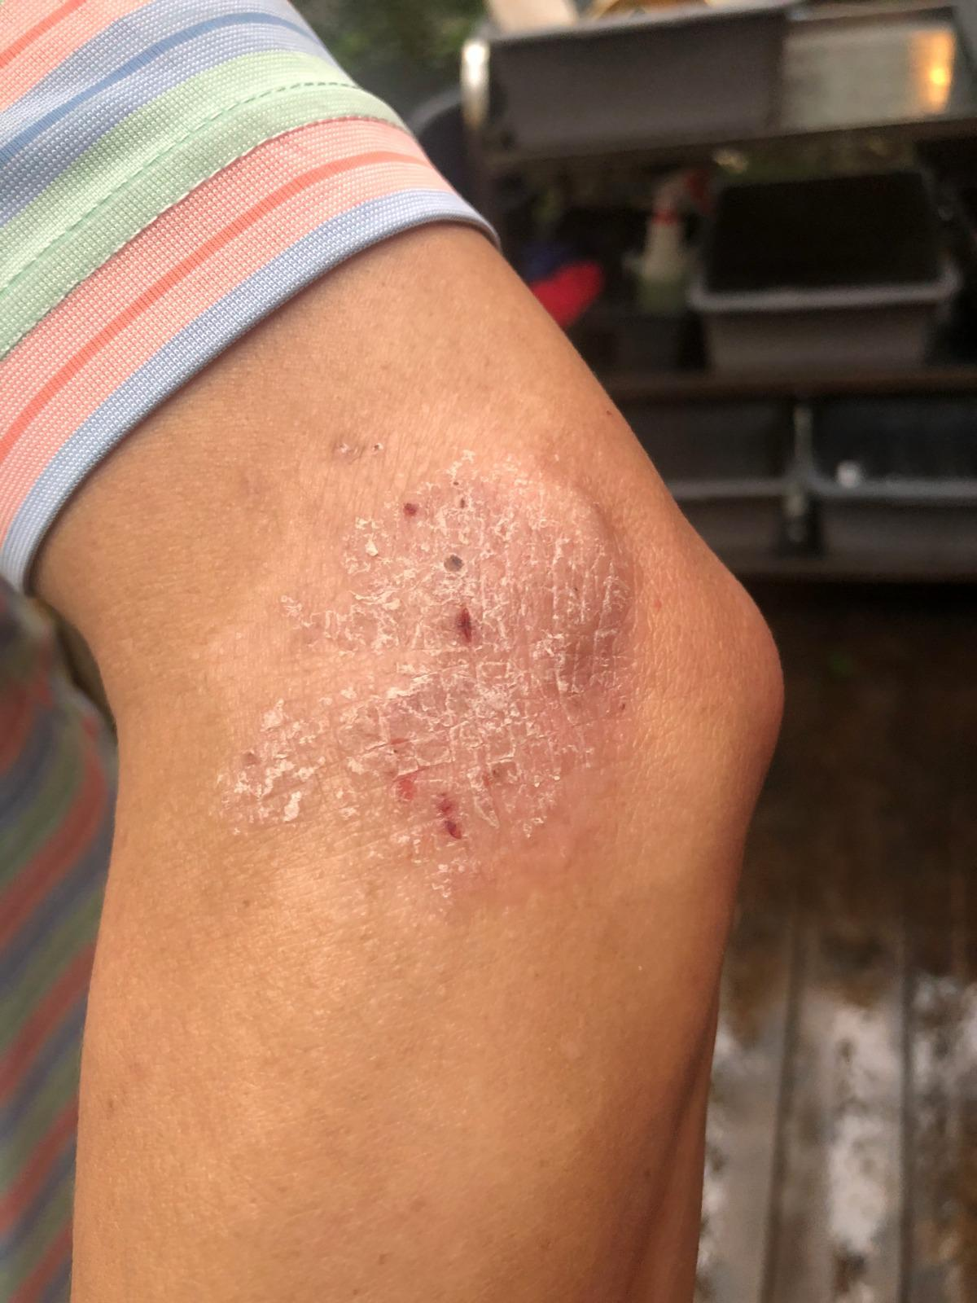
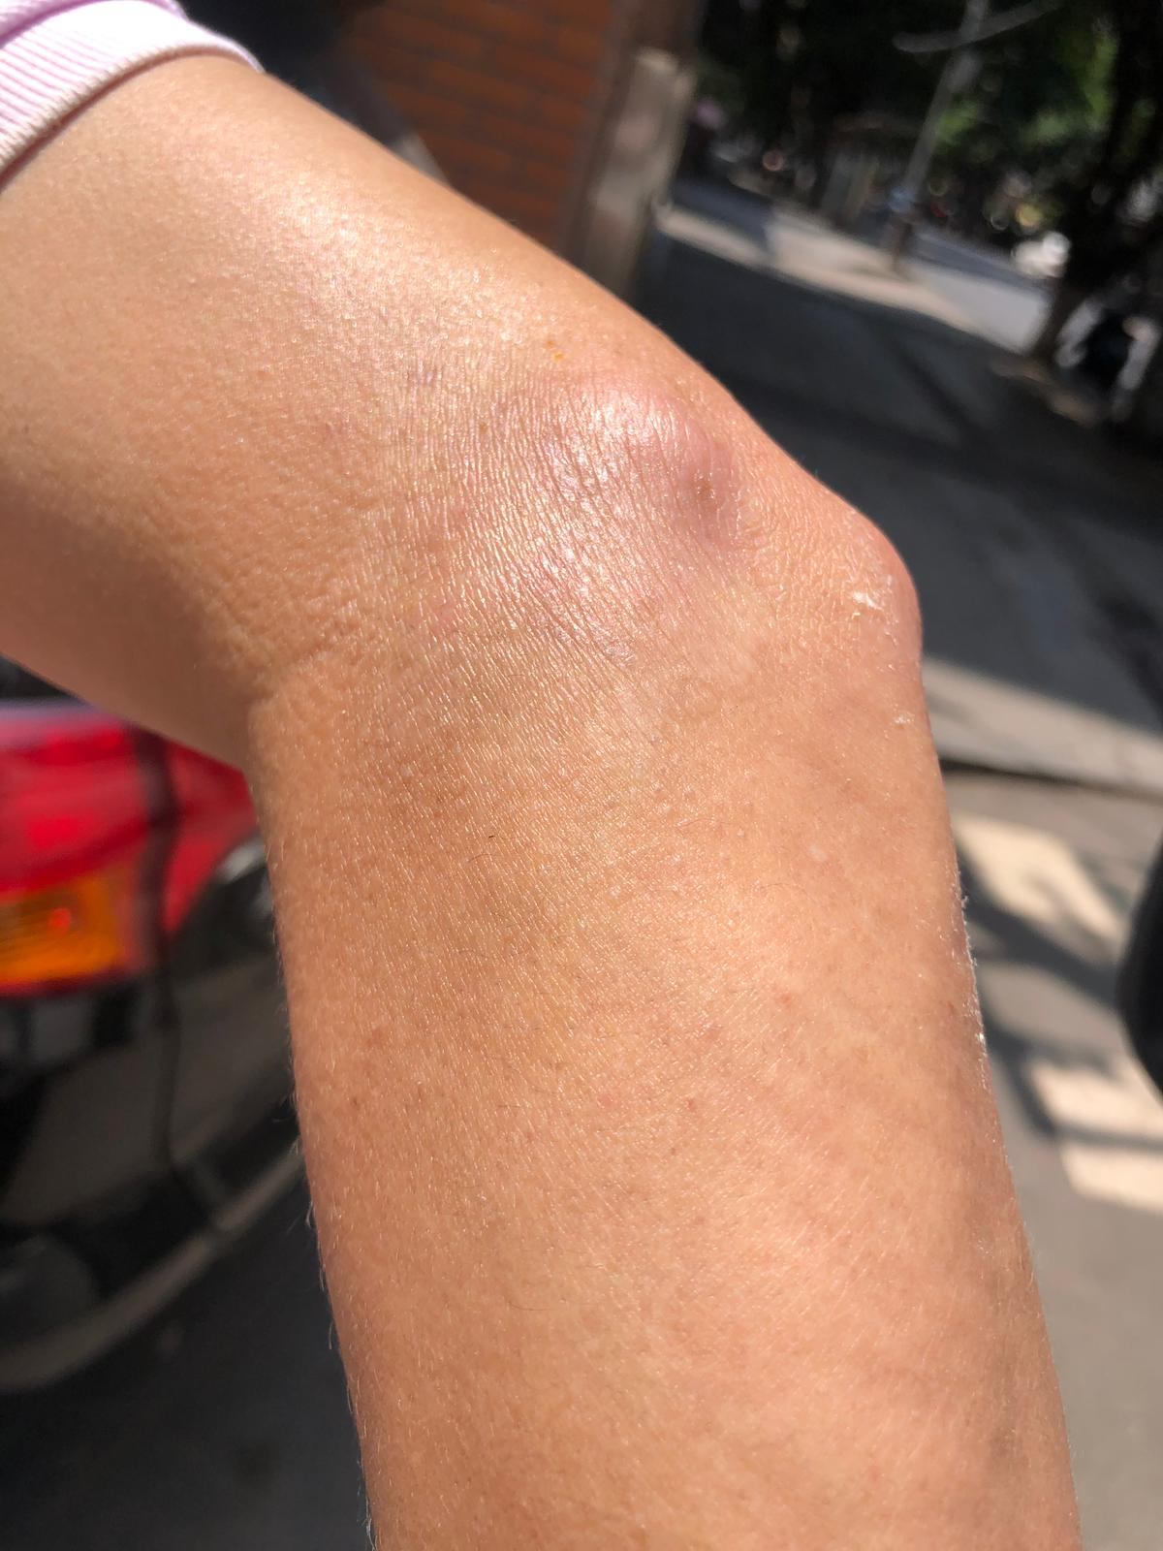
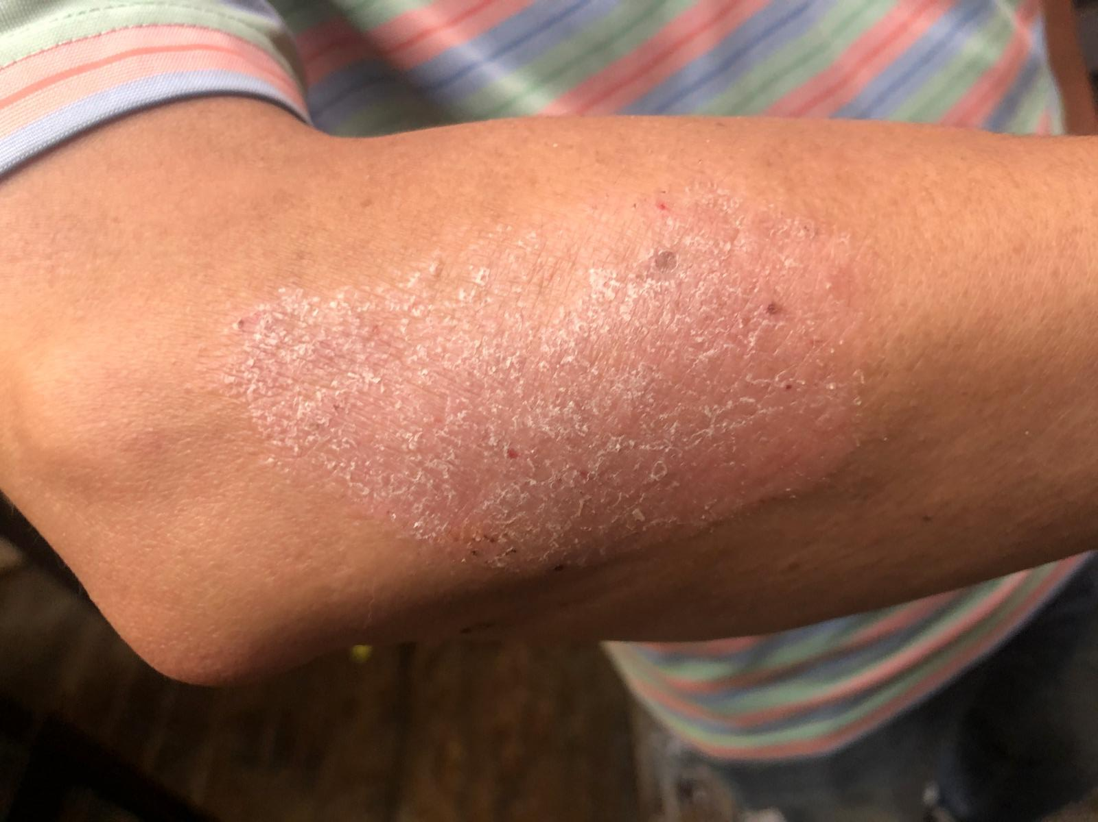
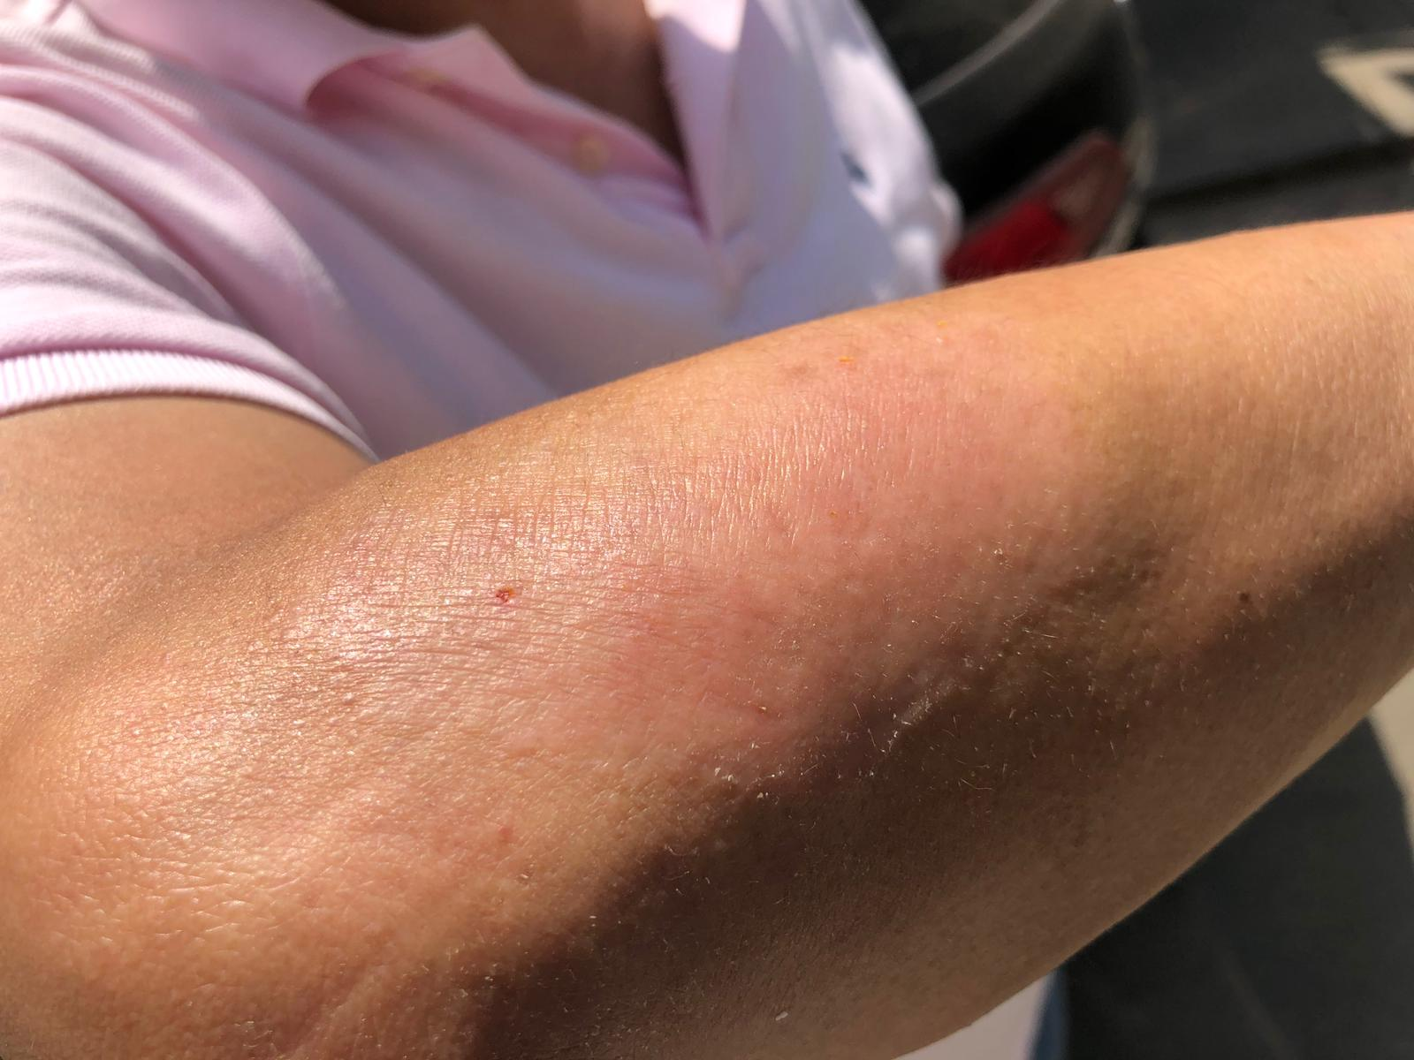
Case Study of Psoriasis Using ET-002
Day 0 Day 7
Day 0 Day 7
Completed: Irritation test of 25 healthy volunteers - no irritation and reports of improved skin appearance.
More information: Reduced acne and wrinkles in collaboration with a large cosmeceutical distributor.
ETTA Biotechnology

Slide 16
Short mRNA Half-Life Is Often a Major Drawback
ETTA Biotechnology
adapted from Jonathan A Bernstein et al, 2002 PNAS

Slide 17

Our Tunable, Reversible, Controllable Gene Therapy Platform
Transient Cre
Gene X Deleted
Expression of delivered DNA gene can be turned down or off by transient introduction of Cre protein.
Overcomes the transient nature of mRNA for gene delivery as long as wanted or needed.
Gene dose can be turned down for personalized medicine with lower doses of transient Cre
ETTA Biotechnology

Slide 18
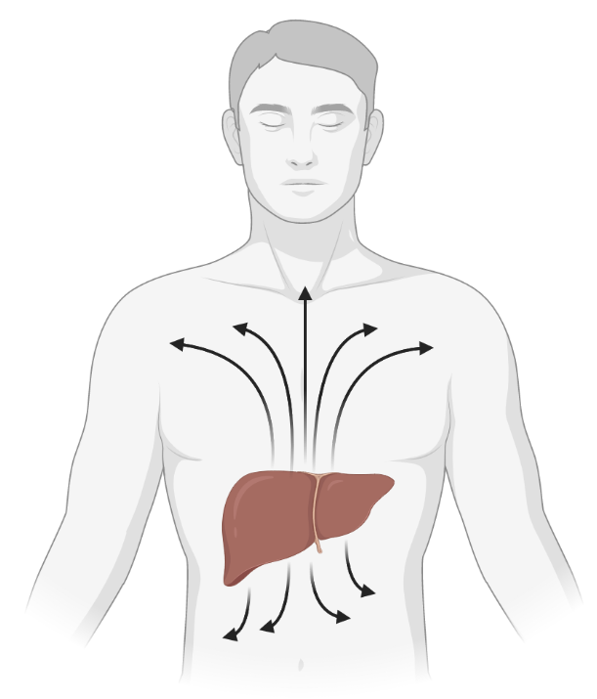
Gene X Nanoparticle: Treatment for High Cholesterol and Lifespan
High Cholesterol - $22.6 Billion per Year Market
94,000,000 Million Patients in the US
Gene X increased lifespan by 40% in transgenic mice, and Gene X protein delivery reduces cholesterol in mice.
In humans, higher Gene X level is associated with lower LDL, higher HDL, lower body weight, lower blood pressure.
Gene X is delivered to the liver with nanoparticles, where it is secreted to the rest of the body.
Gene X
ETTA Biotechnology
ETTA Biotechnology

Slide 19
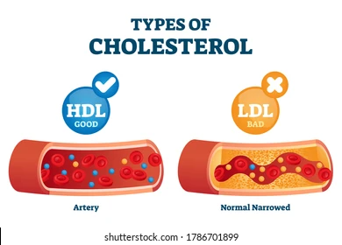
Gene X Analog Clinical Trial
In 1 to 3 weeks:
Total Cholesterol ↓17%
Triglycerides ↓36%
HDL ↑17%
LDL ↓25%
These results indicate mRNA/DNA delivery of Gene X will also work well in human trials.
ETTA Biotechnology
ETTA Biotechnology

Slide 20
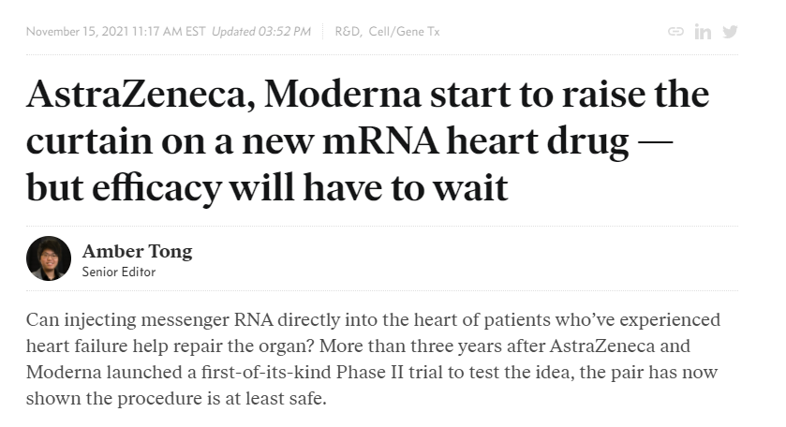

mRNA Is Still in the Medieval Period
ETTA Biotechnology

Slide 21


Targeted Nanoparticles: mRNA/DNA Delivery Platform
Screen 10¹⁴-10¹⁶ targeting molecules in vivo to determine cell and tissue specificity.
Goal: 200+ potential patents for targeted nanoparticles to every cell and tissue type.
ETTA Biotechnology
Tapash Jay Sarkar et al, 2020 Nat Commun

Slide 22
mRNA Reprogramming Nanoparticle
Creating iPSCs to restore youthful cells compliments other therapies because it will make a stem cell niche to rejuvenate tissues.
Will deliver to specific cells and tissues with our targeting tech.
Improved Reprogramming
ETTA Biotechnology
Tapash Jay Sarkar et al, 2020 Nat Commun

Slide 23



Revenue Model
1. Internally develop FDA approved therapies using our nanoparticle platform
2. Externally license targeted nanoparticles to mRNA and DNA delivery companies.
ETTA Biotechnology

Slide 24
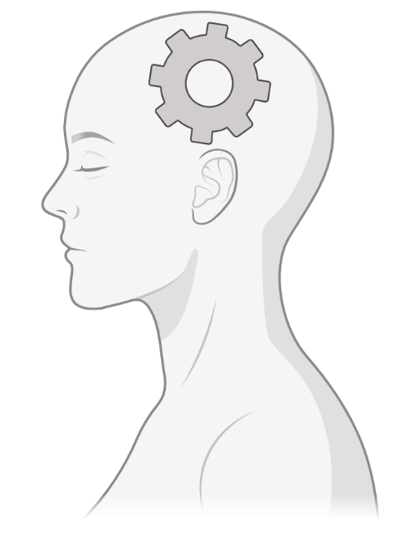
Immediate and Long-Term Strategy
1. Deliver most effective current treatments targeting aging because aging causes >90% of deaths from disease in
the US (100x larger risk factor than typical drug targets).
2. Develop nanoparticle platform to target specific cells and tissues with mRNA and DNA for licensing and therapies.
3. Determine complementarity of our stand-alone therapies using machine learning (ML) models of aging for an
unmatchable suite of treatments.
ETTA Biotechnology

Slide 25



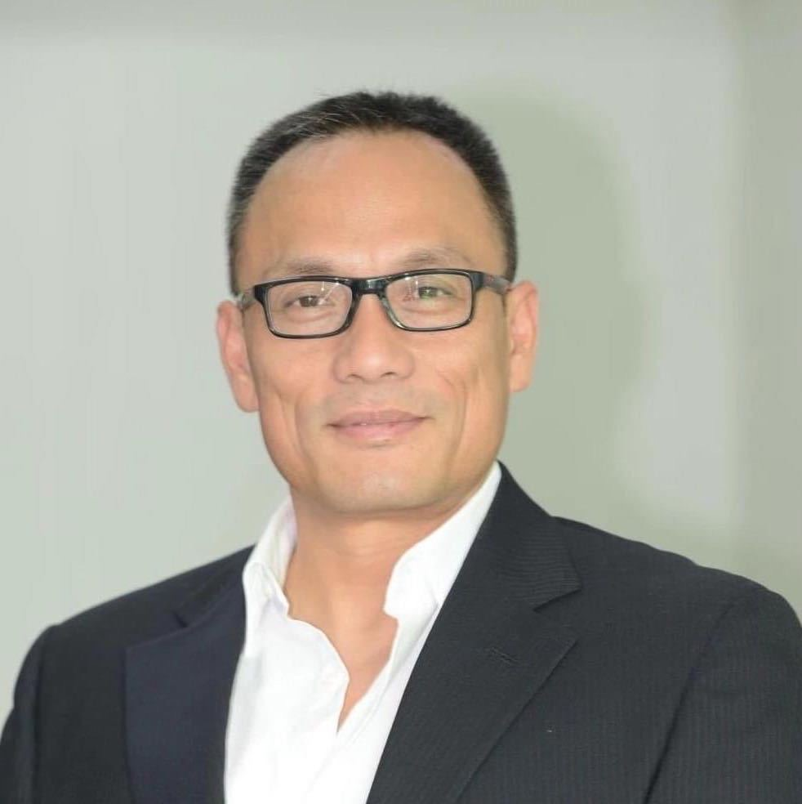
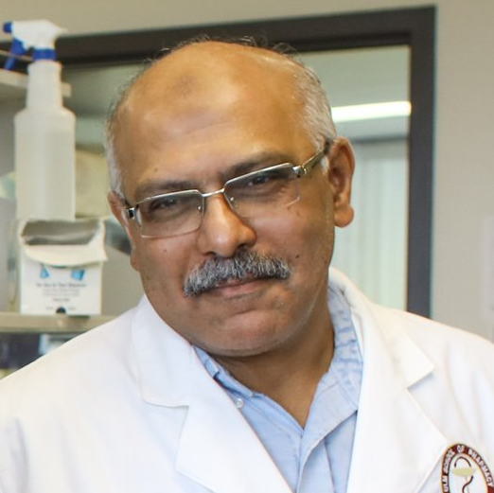
Team
Kyle Brewer, PhD
Matt Yousefzadeh, PhD
15 years experience with nanoparticles, including for drug delivery, mRNA delivery, DNA delivery, tissue targeting, and aging
Assistant Professor - U. of Minnesota
Discovered Fisetin is a Senotherapeutic
and Extends Lifespan
Lulu Lorien, MSFA
Jean Chamcheu, PhD
2019
5 years experience in cosmeceutical and nanotechnology industries
Assistant Professor - U. of Louisiana Monroe
Dermatology of Fisetin Topicals
Biao Zhang, PhD
Khalid El Sayed, PhD
30 years experience as a serial entrepreneur in nanotechnology with multiple successful exits
Reflectivity, Inc acquired by Texas Instruments in 2008
True Material acquired by Affymetrix in 2011
Professor - U. of Louisiana Monroe
Pharmacology of Fisetin
ETTA Biotechnology

Slide 26
Kyle Brewer
ETTA Biotechnology
M: +1.704.806.6760
kyle@ettabiotechnology.com
ETTA Biotechnology

